Slide 1
LED eco-innovation and diffusion: What can policy makers do?
cycLED policy workshop
http://gossart.wp.mines-telecom.fr/cycled-policy-workshop/
Melia Hotel, Berlin, 19 May 2015 (11:00 – 13:00).

Slide 2
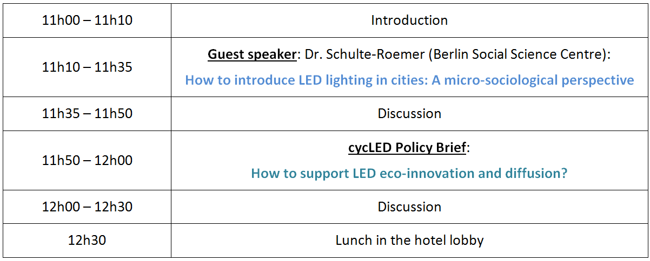
Programme

Slide 3
http://gossart.wp.mines-telecom.fr/files/2015/05/cycLED-Policy-Brief.pdf

Slide 4
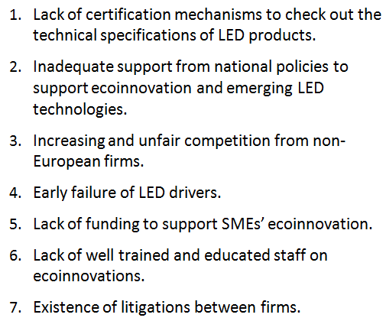
Major barriers to ecoinnovation

Slide 5
Policy recommendations
Protect European firms from unfair competition
Promote an EU label for LED products and services with a high environmental performance;
European instrument to ensure that LED product technical specifications are accurate;
Barriers to trade for LED products that do not meet key standards such as a long lifespan or a high degree of recyclability.

Slide 6
Policy recommendations
2. Provide support to ecoinnovative LED technologies
Develop specific financial instruments supporting the development of ecoinnovative LED products;
Use Green public procurement to support the diffusion of highly ecoinnovative LED products;
facilitate the access to IPR advice and training by European LED SMEs;
Ensure that the IPR regime in place is more favourable to eco-innovation.

Slide 7
Policy recommendations
3. Support ecoinnovation training and education
Develop training and education programmes across Europe (e.g. integrate eco-innovation issues into management and engineering curricula);
Promote staff exchanges to diffuse ecoinnovation knowledge and practices;
Raise policy makers’ awareness about the ecological challenges and economic opportunities of the transition to sustainable lighting systems.

Slide 8
Please fill in our online survey about barriers to eco-innovation:
http://cycled-survey.eu/
http://gossart.wp.mines-telecom.fr/

