Slide 1
Analysing barriers to eco-innovation: The case of the LED sector
Cédric GOSSART
Institut Mines-Télécom / Telecom Business School
GCW conference, Turin, 20 June 2014

Slide 2
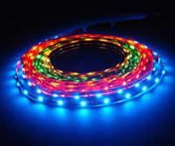
Outline
Introduction
Objectives
Results
Conclusions

Slide 3
Institut Mines-Télécom
26 engineering & business schools

Slide 4
Research in IMT: 9 research networks
Physique et technologies des communications et de l’information
Architectures et gestion des réseaux
Architectures et ingénierie de services et systèmes logiciels
Contenus, connaissances, interactions
Sécurité des systèmes et des services numériques
Santé numérique
TIC et sociétés
TIC & Environnement: http://rt08.wp.mines-telecom.fr
Mathématiques appliquées et informatique fondamentale

Slide 5
1. Introduction
Lighting in a nutshell:
Looking a few thousand years back one finds that fuel combustion has dominated the long history of lighting.
4,500 years ago, in modern day Iraq oil lamps were used to burn oils made from olives and seeds.
The first candles appeared 2000 years ago in Rome.
Gas lighting: the first gasworks was established in 1816 in Freiburg by German mineralogist Lampadius.

Slide 6
Lighting in a nutshell
Early work on incandescent lamps dates from 1840; in October 1879 Edison built and tested a ‘filament lamp’.
By 1881, Edison’s company was manufacturing complete lighting systems (wiring, switches, lamps...).
1997: Japanese electronics company Nichia introduced a white 5 mm LED that produced a single 0.1 W white LED sufficiently bright for reading in complete darkness.
Sources: Bowers, B. (1980); Freeberg (2013).

Slide 7
Current lighting systems: Huge losses
Source: Holmes (1997: 29).

Slide 8
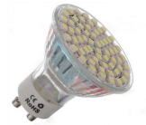
Successive waves of lighting technologies
Highly innovative field (see Cecere et al., forthcoming in Research Policy).
Ecodesigned LEDs are key to the sustainable transition of lighting (cf. my STRN 2014 conf. paper).
LEDs
Environmental benefits?
Source: Wissema (1982), quoted in Olleros (1986: 7).

Slide 9
Lighting technologies timeline
Source: De Almeida, Santos et al. (2014: 32).

Slide 10
LEDs are highly energy efficient
Source: The Climate Group (2012).

Slide 11
Environmental benefits of LEDs
Source: Aman et al. (2013).

Slide 13
2. Objectives of cycLED
Objectives:
Minimize consumption of target metals in LED-products via
Design for longevity, reuse, repair;
Optimized end-of-life of LED products.
Produce highly efficient ecodesigned LED products.
Project Duration: 42 months
1 January 2012 to 30 June 2015
Coordination:
Dr. Otmar Deubzer, Fraunhofer IZM
Financing:
~ 5.4 mio €, co-funding of ~ 4 mio € by EC, FP7 (CP, DG ENV)
cycLED project web page: www.cyc-LED.eu

Slide 14
Need to help innovators overcome barriers to ecoinnovation so that a new lighting regime can emerge
Source: Geels and Schot (2007: 410).

Slide 15
cycLED Work Package 8: Barriers to EI
Identify internal and external barriers within the techno-social system that might limit the exploitation of the proposed ecodesign and eco-innovation measures;
Provide qualitative and quantitative assessments of these barriers;
Suggest ways to overcome these barriers and to enable the innovation and growth of the European LED market.

Slide 16
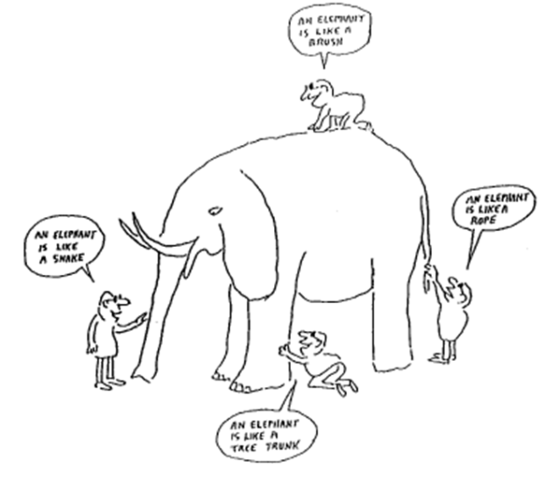
A plea for methodological pluriformity
Source: René Kemp (2012), “Ideas for future research on eco-innovation”, IMT eco-innovation seminar, 1 December, Paris.

Slide 17
Identifying barriers to eco-innovation (Phase I)
Interview guideline prepared, based on a review of the literature:
Internal barriers to ecoinnovation,
External barriers to ecoinnovation.
144 barriers evaluated by 4 firms (=> 576 evaluations): 97 external; 47 internal.
Face-to-face interviews with CEOs or lighting department heads of the four cycLED firms in charge of a demonstrator.
Limits: some barriers might be missing + only 4 firms interviewed => need to expand the analysis beyond cycLED (Phase II).

Slide 18
3. Results
14 major barriers to eco-innovation identified.
Example of a major barrier:
Lack of certification mechanisms to check out the technical specifications of LED products put on the market.
Solutions to overcome this barrier:
Letter to Lighting Europe to support European solution.
High-level policy workshop in Brussels (October 2014).

Slide 19
The 14 major barriers to ecoinnovation

Slide 20
Example of solutions to barriers: Firm n°1
LED drivers are barriers to ecoinnovation (Level 2).
Solution: technician should recommend only reliable drivers => train this technician to detect them.
Staff lacks information on technologies & markets (Level 1).
Solution: Publish articles in magazines as well as on blog.

Slide 21
Example of solutions to barriers: Firm n°2
LED drivers are barriers to ecoinnovation (Level 1).
Solution: Use custom made drivers, change supplier.
The gross intrinsic value of the recycled product is too low, which discourages innovation in recycling technologies (Level 1).
Solution: Prioritise reuse over recycling.

Slide 22
Example of solutions to barriers: Firm n°3
Increasing & unfair competition from non-European firms (Level 2).
Solution: Should be addressed at EU level, e.g. mandatory and well enforced specifications could be required for any LED product put on the EU market.
Marketing and sales channels have not been developed yet (Level 1).
Solutions: Commercial & strategic partnerships, customer information system (newsletter), marketing offensive, funding programmes.

Slide 23
Example of solutions to barriers: Firm n°4
Information systems are sources of rigidity that discourage ecoinnovation (Level 2).
Solution: Adopt a new ERP system.
Existence of litigations between firms (Level 2).
Solutions: The European Parliament should pass laws to avoid abusing of IP by big consortia. The FRAND (fair, reasonable, and non-discriminatory) licensing scheme could be promoted.

Slide 24
Patents as barriers to eco-innovation
“large increase in patent activity concerning the recovery of REMs as well as extraction or recovery of noble metals (i.e. gold, silver or platinum) from e-waste streams.”
“Recovery of rare earth metals not only is fast growing, but also is one of the most heavily protected technologies in terms of geographic extension of protection.”
Source: WIPO (2013), Patent Landscape Report on E-Waste Recycling Technologies.

Slide 25
4. Conclusions
Main barriers to ecoinnovation have been identified by cycLED SMEs.
Solutions have been proposed to overcome these barriers & ensure the success of cycLED demonstrators.
cycLED also aims to strenghten the European LED sector => Survey of European firms and other stakeholders (Phase II).
To inform & get support from policy makers, a policy brief will be prepared as well as a high-level policy workshop (October 2014).

Slide 26
Thank you for your attention
Cédric GOSSART
http://gossart.wp.mines-telecom.fr/
Coordinator of the ICT & Environment research network
http://rt08.wp.mines-telecom.fr

Slide 27
Analysis of LED patents
(patent set = 16,654)
Notes:
The number of patent analyzed in this study is 16,654, all published by
USPTO.
All patent analysis are carried out in PATSTAT 2013 Oct. edition on H01L33/00
- 33/64 IPC classes, shortly H01L33.

Slide 28
Analysis of LED patents

Slide 29
Analysis of LED patents

Slide 30
Institut Mines-Télécom

Slide 31
IMT: Key figures
10 schools
2 subsidiary schools
2 strategic partners
13 associated schools
12,555 students
1,725 PhD students
+4000 graduates per year
Including over 2,500 engineers
8% engineering degrees issued in France
32 % foreign students
38 % grant holders
4, 800 staff members
2,000 researchers
2 Carnot Institutes
€121 M research-generated income per year
About 100 business start-ups per year at the schools’ incubators
NB: 2012 data, excluding associated schools.

Slide 32
cycLED members & activities
Research,
Academic
Fraunhofer IZM (DE, Coordination, WP2, 5)
EcoDesign Center Wales (EDCW, UK; WP2, 6)
Institut Mines-Télécom (IMT, FR; WP8)
Nottingham Trent University (NTU, UK; WP3)
OUT (DE; WP4)
Sirris (BE; WP7)
ELPRO Elektronik-Produkt Recycling GmbH (DE; WP5)
Braun Lighting Solutions (DE; WP4, demonstrator1)
ONA (ES; WP4, demonstrator 3)
Riva GmbH Lighting (DE; WP4, demonstrator 4)
ETAP Lighting (BE; WP4, demonstrator 2)
Philips Lighting (NL; WP6)
Umicore (BE; WP5)
SMEs
Larger Companies

Slide 33
Interview guideline & collected data

Slide 34
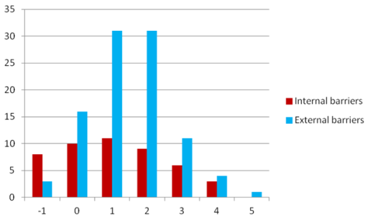
Distribution of barriers per score

Slide 35
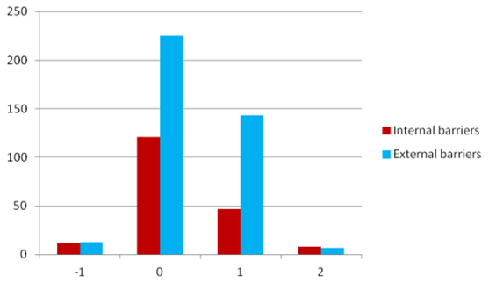
Distribution of barriers per level
14 barriers

Slide 36
Example of solutions to barriers
Lack of certification mechanisms to check out the technical specifications of products put on the market.
Network with EU and national policy makers;
Call for support from industry associations and European Commission (see e.g. US DoE “LED Lighting Facts”);
Use European standard organisations; Government authorities should exert market control on CE marking; the professional association Lighting Europe should promote the ENEC labels.
Notes:
ENEC is the high quality European Mark for electrical products that demonstrates compliance with European standards (EN).
In the US, the US DoE “LED Lighting Facts” programme aims “to assure decision makers that the performance of solid-state lighting (SSL) products is represented accurately as products reach the market” (http://www.lightingfacts.com).

Slide 37
Example of solutions to barriers
LACK OF IN-HOUSE SOURCES OF FINANCE.
Call for banking support + extend capital through shareholders;
Improve organisational efficiency;
Develop commercial and strategic partnerships;
Conduct market analyses for sales department and production (LED components);
Apply to funding programmes;
Create a customer information system (newsletter).

Slide 38
Analysis of LED patents
Notes:
From the news section of the ledsmagazines.com alliance and litigation data are also obtained. In some cases, litigation or risk of litigation is resolved with an alliance.
Professor Gertrude Rothschild is show as an important node. She made important contribution to the LED industry with her researches and throughout her carreer she was awarded with various patents. Towards the end of life of her patents she started various litigation with diverse ﬁrms in the US courts. By reading all news related to the litigation it is understood that some of the
resolution of litigations are also kept secret.

Slide 39
cycLED and gender mainstreaming
Main objective: Investigate possible developments in the cultural association of technology and masculinity within sustainable development, which could impact (positively or negatively) women’s participation in eco-innovation.
Method: Face to face interviews with 5 staff members from 2 cycLED partners (ETAP, IZM).
Status: Interviews are being transcribed, they will be coded and analysed between June & October 2014.

