Slide 1
Eco-innovation dynamics in the LED sector
Cédric GOSSART
Institut Mines-Télécom / Telecom Business School
15th ISS conference, Jena, 28 July 2014.

Slide 2
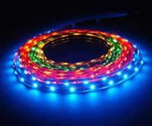
Outline
Introduction
Objectives
Methods
Results

Slide 3
1. Introduction
Lighting in a nutshell: Stage 1 (flame-based lighting)
Fuel combustion has dominated the long history of lighting:
4500 years ago: in modern day Iraq oil lamps were used to burn oils made from olives and seeds.
2000 years ago: the first candles appeared in Rome.
200 years ago: first gasworks established in Freiburg by Lampadius (German mineralogist).

Slide 4
1. Introduction
Lighting in a nutshell: Stage 2 (electricity-based lighting)
Early work on incandescent lamps dates from 1840; in October 1879 Edison built and tested a ‘filament lamp’.
By 1881, Edison’s company was manufacturing complete lighting systems (wiring, switches, lamps...).
1970s: red LEDs.
1997: white LEDs (Nichea, JP).
Sources: Bowers, B. (1980); Freeberg (2013).

Slide 5
1. Introduction
Source: De Almeida, Santos et al. (2014: 32).

Slide 6
1. Introduction
Source: http://www.cree.com/News-and-Events/Cree-News/Press-Releases/2014/March/300LPW-LED-barrier.

Slide 7
More heat than light!
Source: Holmes (1997: 29).
Notes:
Only 8% of the energy consumed to light roads is actually used to produce downward light.
;-) Phil Mirowsky, More heat than light, 1989, CUP.

Slide 8
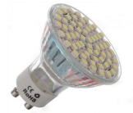
What solutions to inefficient lighting?
Highly innovative field (see Cecere et al., Research Policy, June 2014).
LEDs
Environmental benefits of LEDs?
Source: Wissema (1982), quoted in Olleros (1986: 7).

Slide 9
Energy benefits of LEDs
Source: The Climate Group (2012).

Slide 10
Environmental benefits of LEDs: There is room for improvements!
Source: Aman et al. (2013).

Slide 11
What’s next? Ecodesigned LEDs to prevent ‘destructive creation’
Source: http://www.sussex.ac.uk/spru/documents/marie-jahoda-lecture-2011.pdf.
Notes:
C’est tardivement que les héritiers intègrent les enjeux écologique, en soulignant non sans raison que la supposée « destruction créatrice » de leur mentor JAS avait une face cachée dans le creusement d’inégalités et l’aggravation des crises écologiques.

Slide 12
Identify & overcome
barriers to eco-innovation
in the LED sector (cycLED WP8)

Slide 14
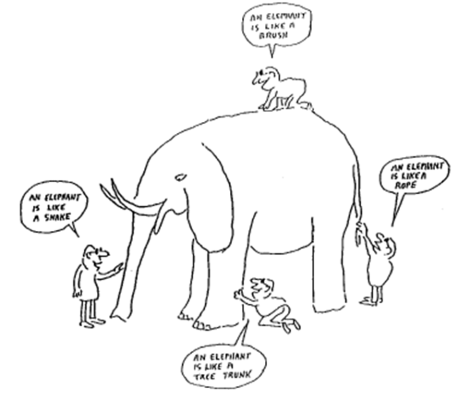
A plea for methodological pluriformity
Phase I:
Qualitative & explorative
Phase II:
Quantitative & extensive
Source: René Kemp (2012), “Ideas for future research on eco-innovation”, IMT eco-innovation seminar, 1 December, Paris.
Notes:
In this presentation we focus on Phase I.

Slide 15
Method for Phase I
Interview guideline prepared, based on a review of the literature:
Internal barriers to ecoinnovation,
External barriers to ecoinnovation.
144 barriers evaluated by 4 firms => 576 evaluations (guideline in paper appendix).
Face-to-face interviews with CEOs or lighting department heads of the four cycLED firms in charge of a demonstrator.
Limits: Some barriers might be missing & only 4 firms interviewed =>
Phase II to deepen the analysis & extend it to other stakeholders.

Slide 17
Results of Phase I (cycLED, WP8)
60% of the 144 barriers were irrelevant.
10% were major barriers.
Heterogeneous evaluation of barriers:
Only 1 major barrier was common to 2 firms: Lack on in-house sources of finance.
Only 1 barrier reached a global score of 5.

Slide 18
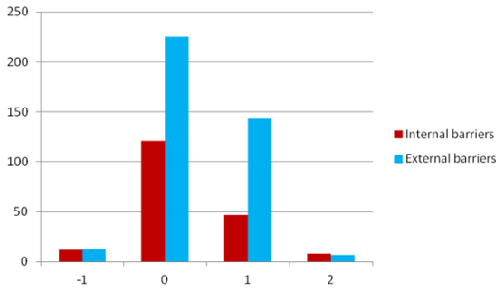
Distribution of barrier evaluations per level
Barriers evaluations for…
14 major barriers
14 majors barriers

Slide 19
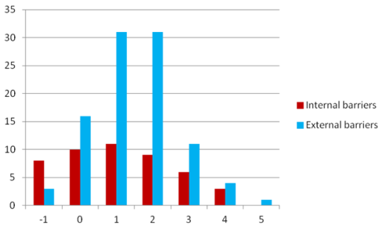
Distribution of barriers per global score
Only 1 barrier with a global score of 5
(maximum = 8)

Slide 20
14 major barriers to ecoinnovation (Phase I)

Slide 21
Solutions to the barriers (Phase I)
Solutions suggested for each firm (examples in backup slides).
Involvement of EU & other policy makers
(high-level policy workshop, Brussels, December 2014).
Further research (Phase II):
Wesley Cohen (speech ISS 27 July): external sources of invention are very important.
Do patents prevent eco-innovation in the LED sector?
(ecodesigning LEDs requires using various knowledge fields)

Slide 22
Evolution of LED patents:
Phase II: Are patents barriers to eco-innovation?
Huge increase in the past 20 years…
… but decline in 2013!
(not seen here)
Notes:
The number of patent analyzed in this study is 16,654, all published by USPTO.
All patent analyses were carried out using PATSTAT 2013 Oct. edition on H01L33/00 33/64 IPC classes, shortly H01L33.

Slide 23
Technological paths of LED technologies
Phase II

Slide 24
Phase II
Litigation cases on the LED sector
Notes:
From the news section of the ledsmagazines.com alliance and litigation data are also obtained. In some cases, litigation or risk of litigation is resolved with an alliance.
Professor Gertrude Rothschild is show as an important node. She made important contribution to the LED industry with her researches and throughout her carreer she was awarded with various patents. Towards the end of life of her patents she started various litigation with diverse ﬁrms in the US courts. By reading all news related to the litigation it is understood that some of the
resolution of litigations are also kept secret.

Slide 25
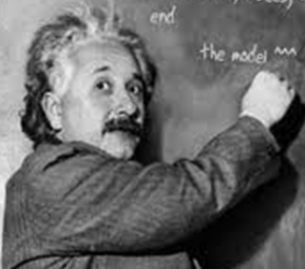
Innovation is dead,
long live
eco-innovation!

Slide 26
Thank you.
http://gossart.wp.mines-telecom.fr/
Coordinator of the ICT & Environment Research Network
http://rt08.wp.mines-telecom.fr

Slide 27
Backup slides

Slide 28
Interview guideline & collected data (Phase I)
Firm1
Firm 2
Firm 3
Firm
4

Slide 29
Example of solutions to barriers
Lack of certification mechanisms to check out the technical specifications of products put on the market.
Network with EU and national policy makers;
Call for support from industry associations and European Commission (see e.g. US DoE “LED Lighting Facts”);
Use European standard organisations; Government authorities should exert market control on CE marking; the professional association Lighting Europe should promote the ENEC labels.
Phase I
Notes:
ENEC is the high quality European Mark for electrical products that demonstrates compliance with European standards (EN).
In the US, the US DoE “LED Lighting Facts” programme aims “to assure decision makers that the performance of solid-state lighting (SSL) products is represented accurately as products reach the market” (http://www.lightingfacts.com).

Slide 30
Example of solutions to barriers
LACK OF IN-HOUSE SOURCES OF FINANCE.
Call for banking support + extend capital through shareholders;
Improve organisational efficiency;
Develop commercial and strategic partnerships;
Conduct market analyses for sales department and production (LED components);
Apply to funding programmes;
Create a customer information system (newsletter).
Phase I

Slide 31
Example of solutions: Firm n°1
LED drivers are barriers to ecoinnovation (Level 2).
Solution: technician should recommend only reliable drivers => train this technician to detect them.
Staff lacks information on technologies & markets (Level 1).
Solution: Publish articles in magazines as well as on blog.
Phase I

Slide 32
Example of solutions: Firm n°2
LED drivers are barriers to ecoinnovation (Level 1).
Solution: Use custom made drivers, change supplier.
The gross intrinsic value of the recycled product is too low, which discourages innovation in recycling technologies (Level 1).
Solution: Prioritise reuse over recycling.
Phase I

Slide 33
Example of solutions: Firm n°3
Increasing & unfair competition from non-European firms (Level 2).
Solution: Should be addressed at EU level, e.g. mandatory and well enforced specifications could be required for any LED product put on the EU market.
Marketing and sales channels have not been developed yet (Level 1).
Solutions: Commercial & strategic partnerships, customer information system (newsletter), marketing offensive, funding programmes.
Phase I

Slide 34
Example of solutions: Firm n°4
Information systems are sources of rigidity that discourage ecoinnovation (Level 2).
Solution: Adopt a new ERP system.
Existence of litigations between firms (Level 2).
Solutions: The European Parliament should pass laws to avoid abusing of IP by big consortia. The FRAND (fair, reasonable, and non-discriminatory) licensing scheme could be promoted.
Phase I

Slide 35
Analysis of LED patents
Phase II

Slide 36
The cycLED project
Objectives:
Minimize consumption of target metals in LED-products via
Design for longevity, reuse, repair;
Optimized end-of-life of LED products.
Produce highly efficient ecodesigned LED products.
Project Duration: 42 months
1 January 2012 to 30 June 2015
Coordination:
Dr. Otmar Deubzer, Fraunhofer IZM
Financing:
~ 5.4 mio €, co-funding of ~ 4 mio € by EC, FP7 (CP, DG ENV)
cycLED project web page: www.cyc-LED.eu

Slide 37
cycLED members & activities
Research,
Academic
Fraunhofer IZM (DE, Coordination, WP2, 5)
EcoDesign Center Wales (EDCW, UK; WP2, 6)
Institut Mines-Télécom (IMT, FR; WP8)
Nottingham Trent University (NTU, UK; WP3)
OUT (DE; WP4)
Sirris (BE; WP7)
ELPRO Elektronik-Produkt Recycling GmbH (DE; WP5)
Braun Lighting Solutions (DE; WP4, demonstrator1)
ONA (ES; WP4, demonstrator 3)
Riva GmbH Lighting (DE; WP4, demonstrator 4)
ETAP Lighting (BE; WP4, demonstrator 2)
Philips Lighting (NL; WP6)
Umicore (BE; WP5)
SMEs
Larger Companies

Slide 38
cycLED and gender mainstreaming
Main objective: Investigate possible developments in the cultural association of technology and masculinity within sustainable development, which could impact (positively or negatively) women’s participation in eco-innovation.
Method: Face to face interviews with 5 staff members from 2 cycLED partners (ETAP, IZM).
Status: Interviews are being transcribed, they will be coded and analysed between June & October 2014.

Slide 39
Institut Mines-Télécom

Slide 40
Institut Mines-Télécom
26 engineering & business schools

Slide 41
IMT: Key figures
10 schools
2 subsidiary schools
2 strategic partners
13 associated schools
12,555 students
1,725 PhD students
+4000 graduates per year
Including over 2,500 engineers
8% engineering degrees issued in France
32 % foreign students
38 % grant holders
4, 800 staff members
2,000 researchers
2 Carnot Institutes
€121 M research-generated income per year
About 100 business start-ups per year at the schools’ incubators
NB: 2012 data, excluding associated schools.

Slide 42
Research in IMT: 9 research networks
Physique et technologies des communications et de l’information
Architectures et gestion des réseaux
Architectures et ingénierie de services et systèmes logiciels
Contenus, connaissances, interactions
Sécurité des systèmes et des services numériques
Santé numérique
TIC et sociétés
TIC & Environnement: http://rt08.wp.mines-telecom.fr
Mathématiques appliquées et informatique fondamentale

