Slide 1
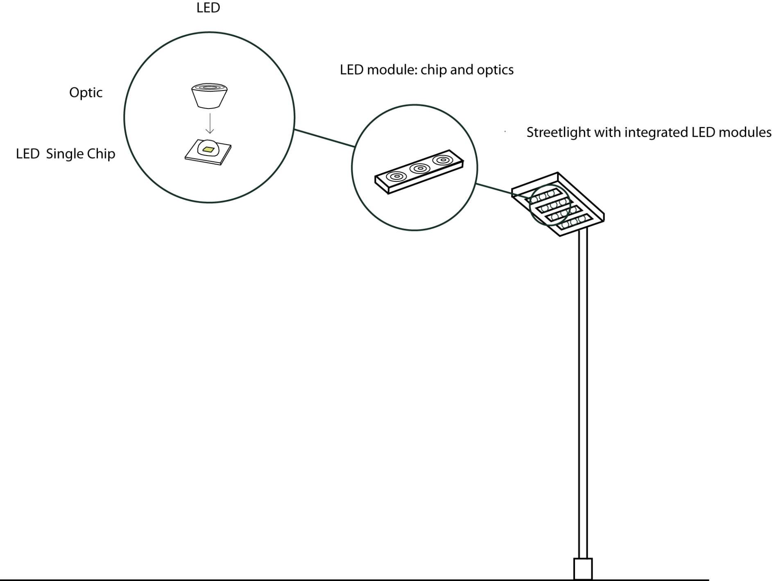
WZB
Berlin Social Science Center
Lighting Cities with LEDs
Nona Schulte-Römer
© Etta Dannemann
Notes:
Some findings from my research!
Now you already know who I am. This presentation is about light technological innovation but I look at it from a non-technological and mostly non-economic point of view.
My argument will be twofold:
I show that innovating in public (that is the introduction of LED lighting cities) follows different rules than innovation activities in R&D labs and on markets. This particularly concerns the evaluation of LED lighting.
I argue that it might be more helpful to think about LED lighting as a resource rather than products, as something that needs to be adapted, interpreted and worked with rather than something product-like specific. In other words, LED lighting is what you make of it.
This perspective on the ongoing innovation process implies a change in perspective, namely from the producer to the user perspective, and the acknowledgement that LED lighting is more than technology and innovation is more than an economic endeavour.

Slide 2
Today
‚Innovation‘ from a sociological point of view
Lessons learnt from Berlin and Lyon
Policy recommendations

Slide 3
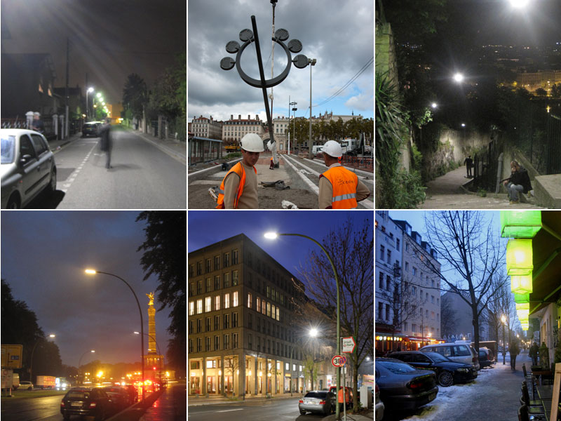

Slide 4
1. A sociological point of view
Innovation activities do not end with the implementation of LED lighting in urban spaces.
Three changes in perspective:
from LED-producer to LED user
from laboratory to street
from products to practices

Slide 5
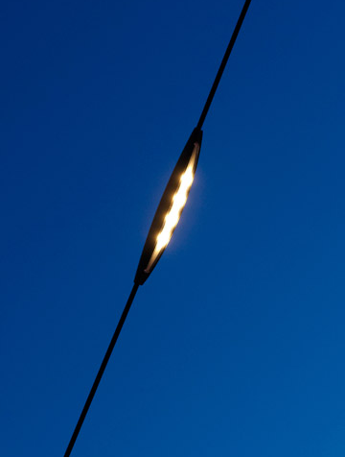
City-specific LED lighting solutions
Berlin: ‘reassuring’ Lyon: ‘cutting-edge’
Notes:
One of my most exciting findings was that Berlin has introduced a very different version of LED lighting. I describe this version as a ‚reassuring configuration‘ and link this unorthodox approach – the imitation of gas light with LED technology – to the Berlin specific gas-light public.
In contrast, Lyon has introduced and still tests and introduces the latest technological developments: digitally controllable, dimmable, presence controlled LED lights. I showed that this can be understood as an effect of Lyon‘s city-specific audiences for public lighting, which are international, competent, interested and open to technological innovation and close to the European lighting industry.

Slide 6
2. Lessons learnt from Berlin and Lyon
Structures and infrastructures matter
Light planning makes a difference
Pilot projects can be useful

Slide 7
Structures and infrastructures
Berlin: dimmed LEDs make no sense ’

Slide 8
Structures and infrastructures
From blue collar to white collar work ’

Slide 9
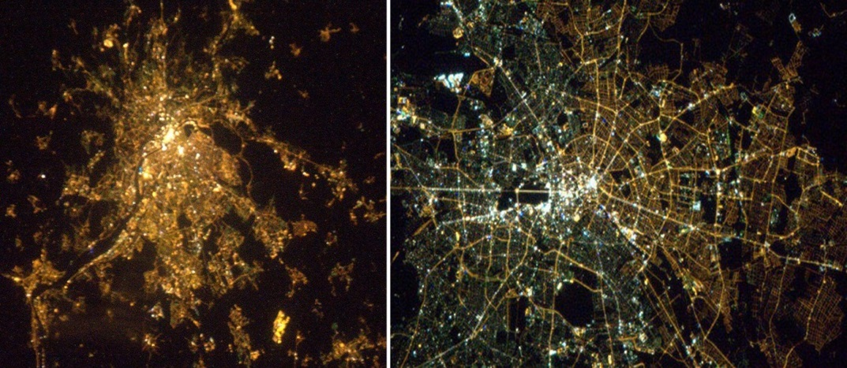
Light planning
Exchange across departments, public attention

Slide 10
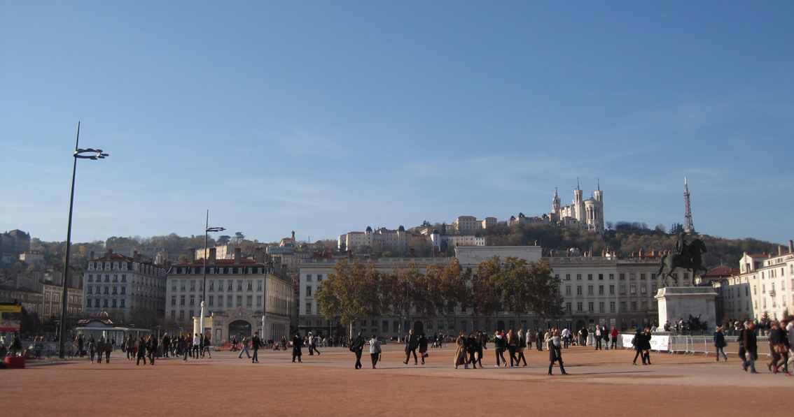
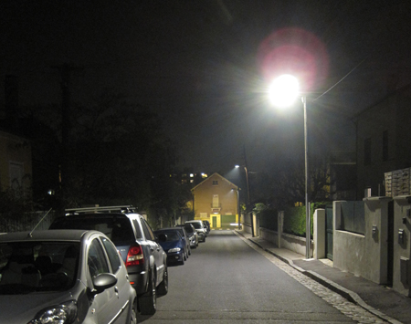
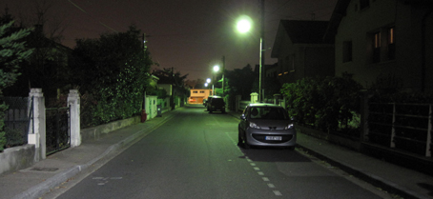
Pilot projects
Choose sites carfully! Demonstration vs. testing

Slide 11
3. Policy recommendations
Building on cycLED Policy Brief
„lack of well-trained staff“ > careful with PPPs
„inadequate national support“ > support for overcoming obdurate structures
„staff exchange“ > Pilot projects as sites for learning rather than perfect demonstrations
„awareness of policy makers“ > Make LED lighting public, beyond energy & cost efficiency

Slide 12
Thank you!

