Slide 1
The social aspects of eco-innovation
Cédric GOSSART
Associate Professor, TEM
Seminar given at the Copenhagen Business School, Department of Business and Politics, 9 September 2015.

Slide 2
Cédric GOSSART
PhD from U. of Sussex (SPRU), 2004
Current position: Associate Professor in TEM since 2007
Now working on ICT & environment
Networks: RT8 (IMT), ÉcoInfo (CNRS)
More details:
http://gossart.wp.mines-telecom.fr

Slide 3
Institut Mines-Télécom
26 engineering & business schools
http://www.mines-telecom.fr/

Slide 4
IMT: Key figures
12,555 students
1,725 PhD students
+4000 graduates per year
Including over 2,500 engineers
8% engineering degrees issued in France
32 % foreign students
38 % grant holders
2,000 researchers
4, 800 staff members
2 Carnot Institutes
€121 M research-generated income per year
About 100 business start-ups per year at the schools’ incubators

Slide 5
This presentation
What is eco-innovation?
Definitions
Case studies
The social aspects of eco-innovation
Definition
The case of lighting transition

Slide 6
Definitions (references in JEE paper)
Kemp and Oltra (2011: 249):
Eco-innovations are “innovations whose environmental impact on a life cycle basis is lower than those of relevant alternatives”.
3 categories of env. impacts:
Pollutions
Exhaustion of nat. resources
Global env. changes
Source: Cecere, G., N. Corrocher, et al. (2014). Lock-in and path dependence: An evolutionary approach to eco-innovations. Journal of Evolutionary Economics 24(5): 1037-1065.

Slide 7
Definitions (references in JEE paper)
Taylor et al. (2005: 698): eco-innovations safeguard public goods, which are not necessarily protected by standard innovations:
“‘Environmental technology’ refers to everything from ‘end-of-pipe’ pollution control technologies to alternative energy technologies that share the characteristic of helping to maintain the ‘public good’ of a clean environment.”
Source: Cecere, G., N. Corrocher, et al. (2014). Lock-in and path dependence: An evolutionary approach to eco-innovations. Journal of Evolutionary Economics 24(5): 1037-1065.

Slide 8
Definitions (references in JEE paper)
I. What is eco-innovation?
Rennings (2013: 333): eco-innovations (EI) can be a byproduct of other innovations:
“Environmental innovations consist of new or modified processes, techniques, practices, systems and products to avoid or to reduce environmental harms. Environmental innovations may be developed with or without the explicit aim of reducing environmental harm.”
Source: Cecere, G., N. Corrocher, et al. (2014). Lock-in and path dependence: An evolutionary approach to eco-innovations. Journal of Evolutionary Economics 24(5): 1037-1065.

Slide 9
Definitions (references in JEE paper)
European Commission (2011):
“Eco-innovation is any form of innovation resulting in or aiming at significant and demonstrable progress towards the goal of sustainable development, through reducing impacts on the environment, enhancing resilience to environmental pressures, or achieving a more efficient and responsible use of natural resources”
NB: Other definitions are listed in the Table A1 of the JEE paper (in appendix).
Source: Cecere, G., N. Corrocher, et al. (2014). Lock-in and path dependence: An evolutionary approach to eco-innovations. Journal of Evolutionary Economics 24(5): 1037-1065.
Notes:
=> Societal objective of eco-innovation: job creation.

Slide 10
Commonalities between eco-innovations and standard innovations
Case studies: What do they tell us about EI?
Require similar resources to be developed & adopted (knowledge, capabilities, coordination and attention).
Development intentional/unintentional.
Various forms: production equipment, methods and procedures, product designs, product delivery mechanisms, new or modified processes, practices, systems and products.
Can result from organisational changes (transform organisational processes, e.g. recycling schemes, EMAS).

Slide 11
Differences between eco-innovations and standard innovations
Case studies
Eco-innovations have to meet, intentionally or not, specific environmental goals.
The development of eco-innovations depends upon the degree of environmental knowledge and sensibility towards green issues on producers’ and consumers’ sides.
Eco-innovation claims hard to verify (best = LCA), except if they follow strict guidelines, norms, labels or standards.
Notes:
Is the hybrid Cayenne SUV an eco-innovation?

Slide 12
Shouldn’t all innovations be eco-innovations? Why do eco-innovations fail? Because of social events.
Case studies
Brian Arthur (1989): increasing returns to adoption.
Small historical accidents can provide a given technology an initial advantage over competitors that can create path dependence. Cf. Qwerty.
Lock-in may also derive from individuals’ characteristics, attitudes and behaviours (Rogers 1995).

Slide 13
What social aspects cause the lock-in of eco-innovations?
Case studies
Continuous improvements in a given technology further strengthens their market.
For example, the internal combustion engine (ICE) was environmentally improved by efficiency inventions such as direct fuel injection, particle filters, and new combustion concepts (Oltra and Saint Jean 2009).
=> strong and persistent dominant design (most engine innovations still focused on incremental changes within this design + on the consumer side: demand for incremental changes).

Slide 14
Example of power plants (lock-in due to incremental changes)
Case studies
Since 1980: Coal-fired power plants dominate, no radical innovation succeeded (Rennings et al. 2013).
Only changes: technological components (e.g. scrubbing technologies to remove sulphur and nitrogen oxides), no fundamental changes in existing plants to avoid harming productivity.
=> energy efficiency of German power plants gradually improved by combining established gas and steam cycles => lock-in carbon-based plants.
=> old technologies could keep up with newer and more efficient ones (locked in technological niches) => reinforcement of barriers to paradigm shifts.

Slide 15
Example of cars (lock-in due to incremental changes)
Case studies
Social aspects of lock-in => domination of incremental innovations: lack of new infrastructure and capital required for more radical technological changes + sunk costs (Costantini and Mazzanti 2012).
=> emergence of 2 main trajectories (Dijk et al. 2011):
Improvement of vehicles powered by ICE;
Slow diffusion of electricity-powered vehicles.

Slide 16
Other sources of lock-in: Cost-related factors
Case studies
Increasing returns to scale keep costs down, and an existing technology such as the internal combustion engine limits high sunk costs related with the development a new fuel infrastructure.
The importance of the financial commitment required to eco-innovate is often mentioned as a barrier to implement environmental programmes (Noci and Verganti 1999), but it is particularly the case for SMEs (del Brı́o and Junquera 2002; Zutshi and Sohal 2004). E.g. LEDs.

Slide 17
Technological niches and complexity as sources of lock-in
Case studies
The fact that the success of technological niches is highly uncertain deters firms to adopt the technologies nested in those niches.
For example, eco-innovations such as the ones relying on integrated gasification combined cycles or on pressurised pulverised coal combustion hardly made it out of pilot plants or technology niches such as the refining industry.
The regime in place could not reduce the market uncertainties deterring investment in new technologies, and the existing pollution-intensive technological paradigm remained dominant (Rennings et al. 2013).

Slide 18
Technological niches and complexity as sources of lock-in
Case studies
In the case of power plants, it was the lack of radical alternatives which further strengthened the existing pollution-intensive trajectory.
Radical alternative eco-innovations were too weak to enter and change the dominant trajectory, and this very weakness enabled the further strengthening of the more polluting technological regime.

Slide 19
Stakeholders can deter eco-innovations
Case studies
Regulation can strengthen an existing, and possibly inefficient trajectory, by promoting incremental improvements within this trajectory.
Ex. Swiss bioenergy sector: energy policies (electricity feed-in schemes) stimulated investments in wood-to-energy technologies => lock-in to environmentally suboptimal technologies focused on power generation + weakened alternative approaches based on gas generation (Wirth and Markard 2011).

Slide 20
Which social aspects can unlock eco-innovations?
Case studies
Ex. biopolymer technology: centralised established decision processes are the main causes of lock-in (Chadha 2011).
Unlocking process: escape routes found by promoting network diversity (firm alliances, R&D consortia, partnerships, standard organisations, ...).
Firms reduced costs and risk collectively & enhanced technological predictability.
Fostered knowledge diversity: e.g. bootleg research (motivated employees organise part of the innovation process), technology monitoring (encourages to search outside the usual box), involve employees in firms’ road mapping.

Slide 21
Stakeholders can support eco-innovations
Case studies
By promoting technological niches and diversity:
Ex. volatile organic compounds (paints, glues): end 1990s: supportive legislation helped more environmentally friendly paints to increase their sales significantly after 30 y. on the market (Gelderman et al. 2007; Oltra and Saint Jean 2005).
Public S&T programmes = niche applications e.g. calculators and space travel helped improve solar cell efficiency => the technological trajectory of solar cells moved on from a technological niche to a market niche (van den Heuvel and van den Bergh 2009).

Slide 22
Un-locking eco-innovation: The role of regulatory changes
Case studies
Legislative and other regulatory pressures are even the main external forces leading to the adoption of eco-innovations (Nameroff et al. 2004).
Regulatory push is often the first opportunity for firms to start along an eco-innovation path by complying with regulatory standards (van den Heuvel and van den Bergh 2009).
E.g. US large revisions of environmental law during the 1980s and 1990s were followed by a rapid growth in green chemistry patenting.
“There is more evidence of regulations stimulating radical innovation than of market-based instruments doing so.” (Kemp and Pontoglio 2011)

Slide 23
Un-locking eco-innovation: The role of lead users
Case studies
Change in consumer preferences can trigger eco-innovative changes. Ex. the trajectory of personal transportation technologies was disrupted by ecological concerns (Windrum et al. 2009) => awareness important.
Ecological concerns triggered the emergence of heterogeneous consumer preferences => development of cleaner product designs within the dominant technological paradigm => greener paradigm.

Slide 24
Un-locking eco-innovation: The role of lead users
Case studies
Early adopters play a crucial role: attribute meaning to the product => drive eco-innovation by contributing to the emergence of a niche market. E.g. Canadian forestry sector (Sharma and Henriques 2005).
Social process by which early adopters influence markets = social feedback loops (Dijk et al. 2011):
Interactive learning between suppliers and users,
Endogenous tastes among consumers,
Social learning (attribution of meaning).

Slide 25
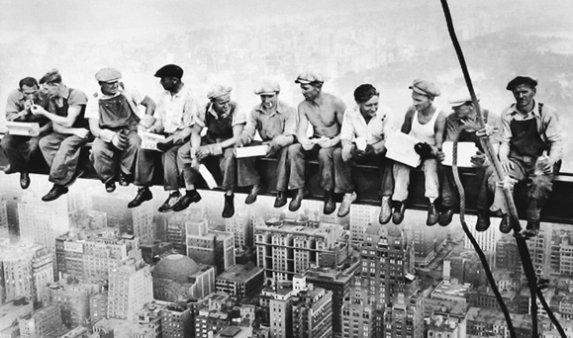
End of Part I
Notes:
Looking at this photo one realises the role of stakeholders in the improvement of health and safety at work…

Slide 26
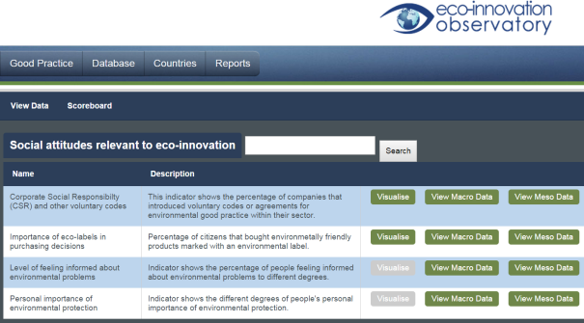
Definition:
II. The social aspects of eco-innovation
Google search “SAEI”: 10 results all related to the EIO.
SAEI =
What actors BELIEVE and DO
Source: http://database.eco-innovation.eu/indicators/index/area:63

Slide 27
Example of a SAEI: people’s beliefs
Are these social aspects of any use to better understand eco-innovations?
Source: Eurobarometer 2014, http://ec.europa.eu/public_opinion/archives/eb_special_419_400_en.htm

Slide 28
Example of a SAEI: people’s behaviour
Definitely useful, and on the rise.
Source: Eurobarometer 2014, http://ec.europa.eu/public_opinion/archives/eb_special_419_400_en.htm

Slide 29
Example of a SAEI: people’s opinions
Excellent social aspect for win-win policies!
Source: Eurobarometer 2014, http://ec.europa.eu/public_opinion/archives/eb_special_419_400_en.htm

Slide 30
Example of a SAEI:
people’s opinion about public policies
Source: Eurobarometer 2014, http://ec.europa.eu/public_opinion/archives/eb_special_419_400_en.htm
Definitely useful!

Slide 31
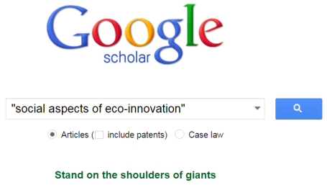
The SAEI: What else do they entail?

Slide 32
“The social aspects of innovation”
Values
Ethical aspects
Social dimension of innovation
Social innovations
Social aspects of innovation diffusion / management / networks:
Diffusion: social aspects of innovation diffusion = exchange of ideas, persuasion, personal influence (Everett Rogers).
Examples*:
Social institution of apprenticeships = critical mechanism for transmitting and accumulating knowledge (Second Industrial Revolution).
Knowledge is socially organized (shared through social networks within and across industries, & through pure and applied science organizations).
Inventor networks & other social networks e.g. ethnic groups.
Social capital.
* Source: Cook, L. D. (2011). Inventing social capital: Evidence from African American inventors, 1843–1930. Explorations in Economic History 48(4): 507-518.

Slide 33
The SAEI in the eco-innovation literature (cf. Part I)
The objective of EI = societal objective (reduce the 3 ecological impacts).
Social factors can block EI (e.g. their diffusion can stop because of actors’ behaviour).
Role of decision processes in EI lock-in (cf. biopolymer centralised DM).
Societal needs can support EI (e.g. responsible consumption).
Stakeholders as well:
Public policies & regulations can support EI (e.g. phasing out of CFCs & ILB), grassroots innovators.
Social interactions & public institutions generate knowledge for EI.
Notes:
Incandescent Light Bulbs

Slide 34
Ex. of SAEI in the LED sector
Main obstacles to eco-innovation for LED firms
www.cyc-LED.eu
Lack of certification mechanisms to check out the technical specifications of LED products.
Inadequate support from national policies to support ecoinnovation and emerging LED technologies.
Increasing and unfair competition from non-European firms.
Early failure of LED drivers.
Lack of funding to support SMEs’ ecoinnovation.
Lack of well trained and educated staff on ecoinnovations.
Existence of litigations between firms.
Source: cycLED Policy Brief, http://gossart.wp.mines-telecom.fr/files/2015/05/cycLED-Policy-Brief.pdf

Slide 35
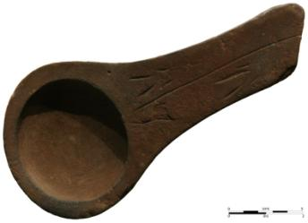
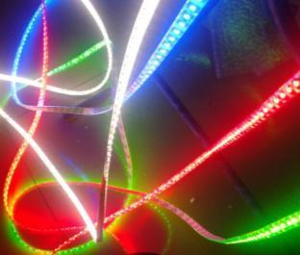
The case of lighting transition
Animal oil lamp, Lascaux, -10000.
https://fr.wikipedia.org/wiki/Lampe_à_huile
LED ribbons
-10,000
2015

Slide 36
Lighting in the world
IEA: the amount of electricity used by lighting sources = 20% global electricity consumption.*
Lighting = greatest share of electricity expenses of many municipalities (=> hydrocarbon energy sources).
Nowadays: switch to LED technologies (reduced ecological impacts).
* Source: Aman, M. M., G. B. Jasmon, et al. (2013). Analysis of the performance of domestic lighting lamps. Energy Policy 52(0), pp. 482-500.

Slide 37
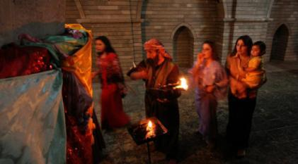
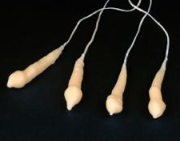
Lighting in a nutshell: Stage 1 (flame-based lighting)
Fuel combustion dominated the long history of lighting:
4,500 years ago: in modern day Iraq oil lamps were used to burn oils made from olives and seeds.
2,000 years ago: the first candles appeared in Rome.
Source: http://www.religion.dk/viden/hvem-er-yazidierne.
Tallow candles (rendered animal fat)
Source: http://www.smith.edu/hsc/museum/ancient_inventions/candles2.html.
Sources: Bowers, B. (1980); Freeberg (2013). References available from https://gossart.wp.mines-telecom.fr/files/2014/07/Gossart-paper_STRN.pdf.

Slide 38
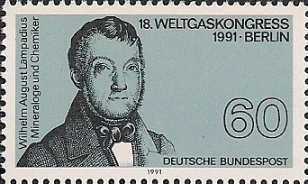
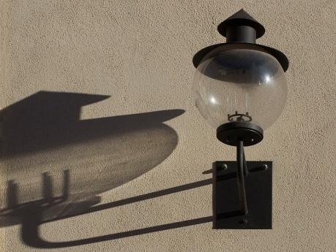
200 years ago: first gasworks established in Freiburg by Wilhelm August Lampadius (German mineralogist).
Lighting in a nutshell: Stage 1 (flame-based lighting)
Source: https://de.wikipedia.org/wiki/Wilhelm_August_Lampadius.

Slide 39
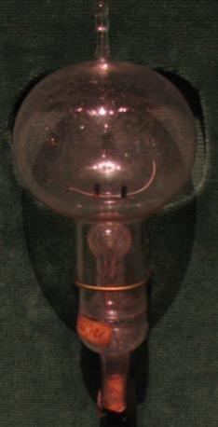
Lighting in a nutshell: Stage 2 (electricity-based lighting)
Edison's original carbon-filament bulb
Early work on incandescent lamps dates from 1840
October 1879: Edison’s ‘filament lamp’
1881: Edison’s company manufactures complete lighting systems (wiring, switches, lamps...)
1962: red light emitting diodes/LED (Holonyak / GE)
1994: blue LED (Nakamura from Nichia)
1997: white LED (Nichia)
Source: https://en.wikipedia.org/wiki/Incandescent_light_bulb.
Sources: Bowers, B. (1980); Freeberg (2013). References available from https://gossart.wp.mines-telecom.fr/files/2014/07/Gossart-paper_STRN.pdf.

Slide 40
The ecological impacts of the lighting transition
Source: De Almeida, Santos et al. (2014: 32). References available from https://gossart.wp.mines-telecom.fr/files/2014/07/Gossart-paper_STRN.pdf.

Slide 41
The ecological impacts of the lighting transition
Source: http://www.cree.com/News-and-Events/Cree-News/Press-Releases/2014/March/300LPW-LED-barrier, March 2014.

Slide 42
The ecological impacts of the lighting transition
The efficacy of LED is much superior to that of other alternatives
Source: The Climate Group (2012). References available from https://gossart.wp.mines-telecom.fr/files/2014/07/Gossart-paper_STRN.pdf.

Slide 43
The ecological impacts of the lighting transition
Source: Aman et al. (2013). References available from https://gossart.wp.mines-telecom.fr/files/2014/07/Gossart-paper_STRN.pdf.

Slide 44
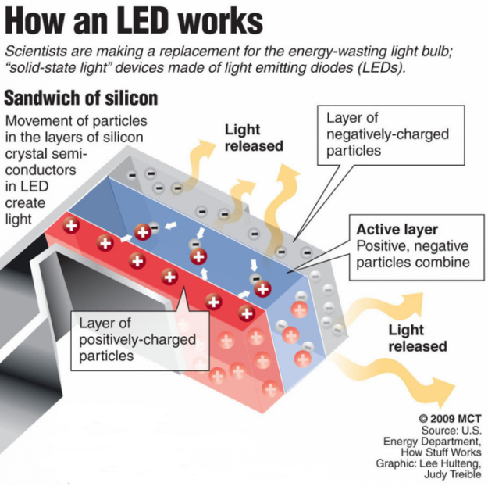
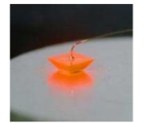
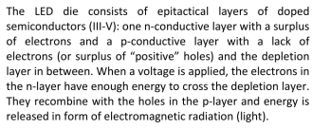
Source: cycLED Deliverable 2.1: Categorization of LED products.

Slide 45
Examples of LED products
Source: cycLED Deliverable 2.1: Categorization of LED products.

Slide 46
… but more heat than light in current lighting systems!
Source: Holmes (1997: 29). References available from https://gossart.wp.mines-telecom.fr/files/2014/07/Gossart-paper_STRN.pdf.
Notes:
Only 8% of the energy consumed to light roads is actually used to produce downward light.
;-) Phil Mirowsky, More heat than light, 1989, CUP.

Slide 47
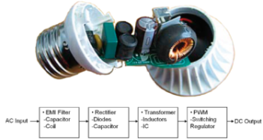
+ LED generate electronic waste
Source: New research shows CFLs and LED light bulbs have higher toxicity and resource depletion than incandescent bulbs. 16/01/2013, http://www.electronicstakeback.com/2013/01/16/new-research-shows-cfls-and-led-lightbulbs-have-higher-toxicity-and-resource-depletion-than-incandescent/.
Original article: http://www.researchgate.net/publication/233913041_Potential_Environmental_Impacts_from_the_Metals_in_Incandescent_Compact_Fluorescent_Lamp_(CFL)_and_Light-Emitting_Diode_(LED)_Bulbs.
Notes:
Only 8% of the energy consumed to light roads is actually used to produce downward light.
;-) Phil Mirowsky, More heat than light, 1989, CUP.

Slide 48
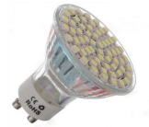
What is the environmental future of lighting?
LED
Highly innovative field (see my paper with Cecere et al., Research Policy, July 2014).
Source: Wissema (1982), quoted in Olleros (1986: 7). References available from https://gossart.wp.mines-telecom.fr/files/2014/07/Gossart-paper_STRN.pdf.

Slide 49
Which ‘aspects’ will drive the ecological transition of lighting?
Source: Geels and Schot (2007: 410). References available from https://gossart.wp.mines-telecom.fr/files/2014/07/Gossart-paper_STRN.pdf.

Slide 50
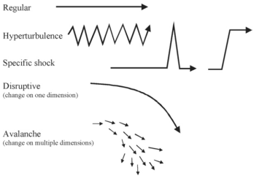
The multilevel perspective (MLP) on transitions: A useful approach to analyse the SAEI
New sociotechnical regime
Source : Geels, F. and J. Schot (2007). "Typology of sociotechnical transition pathways." Research Policy 36(3): 399-417.

Slide 51
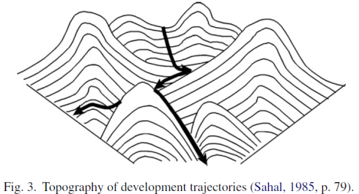
How can we learn more from these aspects?
The social aspects of eco-innovation largely determine the emergence and diffusion of eco-innovations.
We can learn about the social aspects of eco-innovation by studying the role of these social aspects in past technological transitions (including lighting).
Ex. role of social aspects in a transition: government policy (e.g. phasing out of IL bulbs or of CFCs).
Source : Geels, F. and J. Schot (2007). "Typology of sociotechnical transition pathways." Research Policy 36(3): 399-417.

Slide 52
Example n°1: Waste water management in the Netherlands

Slide 53
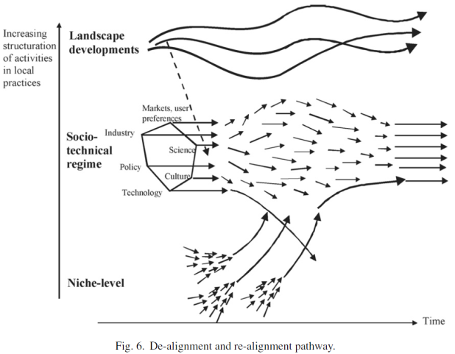
Example n°2: From horse carriages to automobiles.
New sociotechnical regime

Slide 54
Example n°3: From sailing ships to steam-powered boats
1838
social innovation
(public policy)

Slide 55
Example n°3: From sailing ships to steam-powered boats
1838 : social innovation (public policy)

Slide 56
Past lighting transitions
Source: Bowers, B. (1998), Lengthening the day: A History of Lighting Technology, Oxford University Press.

Slide 57
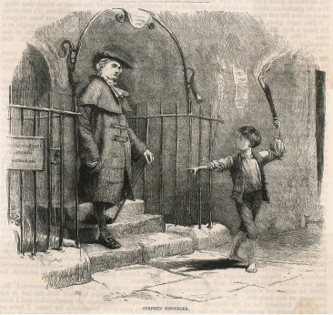
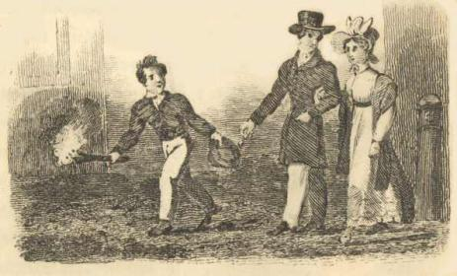
The social aspects of past lighting transitions
“Link boys”
Source: https://janeaustensworld.wordpress.com/2012/04/25/the-difficulties-of-travel-and-transportation-in-early-19th-c-britain/

Slide 58
Lighting and socialising in the 19th c.

Slide 59
Two main categories of lighting
What are the social aspects of their ecological transition?

Slide 60
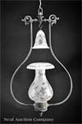
Flame-based light: carbon compounds are heated, become incandescent.
Examples of lighting fuels:
Spermaceti
Stearine
Beeswax
Tallow
Scottish crusie oil lamp
smoke bells for candle holders

Slide 61
Argand lamp (1780)
An eco-innovation?
Improvement in brightness,
More complete combustion of the wick and oil.
Noticeable social aspect: meets a social need for greater efficiency + comfort improvement + saving raw materials.

Slide 62
The consequences of the diffusion of gas light
Fast diffusion of street lighting → electric lighting:
First public street lighting with gas: London 1807
1813: Westminster Bridge lit by gas
1820: 15 towns
1840: 200 towns
1849: 99% towns in Britain
Ecological and social aspects of electric lighting?

Slide 63
Electricity-based light
Humphrey Davy (1808), demonstrated a large-scale arc: light without combustion.
1848: first public demo of an arc lamp in National Gallery, but batteries very expensive (SA barrier = electricity generation.
But not very convenient for domestic lighting => lighting by incandescence: first demo February 1879 by Joseph Swan.

Slide 64
Electrification (=> IL, CFL, LED, …)
Result from the deployment of public infrastructures
1st power station = water mill in 1881, then steam engines (1882)
Noticeable social aspects of electrical inventions:
Use of the media for public relations: 1881 Paris international electrical exhibition: flattering papers in the press about Edison’s lamps (written by his staff)
Creation of organisations which are the largest firms today
1909: first newspaper campaign for an electrical product (Osram)

Slide 65
Ecological & social issues?
1913: gas in bulb => extension of lifetime + coiled filament
Phoebus cartel : Osram, Philips, General Electric, … (1924 --> 1939) to control the manufacture and sale of light bulbs. Firms’ networks inhibit ecological improvements
1960: halogen lamp → 1990s with tungsten halogen lamps (longevity, brighter, more efficient)

Slide 66
Electricity consumption of lighting (EU)
Source: https://ec.europa.eu/jrc/sites/default/files/energy-efficiency-status-report-2012.pdf

Slide 67
Electricity consumption of lighting (USA)
Source: http://apps1.eere.energy.gov/buildings/publications/pdfs/ssl/2010-lmc-final-jan-2012.pdf

Slide 68
Electricity consumption of lighting (USA)
Source: http://apps1.eere.energy.gov/buildings/publications/pdfs/ssl/2010-lmc-final-jan-2012.pdf

Slide 69
Evolution of the energy consumed by street lighting in the USA
-2%
-9%
+18%
-23%
Source: http://apps1.eere.energy.gov/buildings/publications/pdfs/ssl/2010-lmc-final-jan-2012.pdf.

Slide 70
Final remarks
Eco-innovation needs social innovations:
Behavioural changes (ecodesign in firms, responsible consumers)
Regulatory pressures
Knowledge diversity
Ecological awareness raising
…
Studying past transitions helps us shape future ones.
Notes:
ecodesign in firms: no more planned obsolescence!

Slide 71
Thank you.
http://gossart.wp.mines-telecom.fr
Cedric.Gossart@telecom-em.eu
Co-animator of the interdisciplinary ICT & Environment Research Network of IMT
http://rt08.wp.mines-telecom.fr
09/09/2015
Télécom École de Management

