Slide 1
Ecological transition, innovation and ICT
Cédric GOSSART
Associate professor in TEM
LITEM seminar, 12/11/ 2015

Slide 2
2 questions
How can innovation contribute to ecological transition?
What role can ICT play?

Slide 3

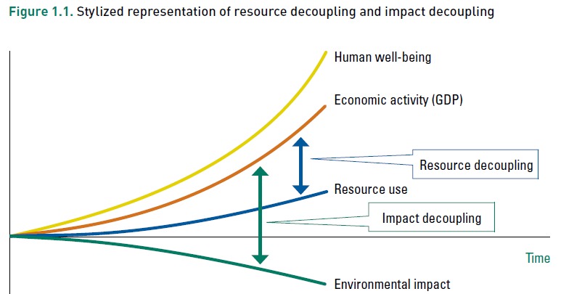
Why ecological transitions?
Source : http://www.unep.org/resourcepanel/Publications/Decoupling/tabid/56048/Default.aspx .

Slide 4

What is innovation?
“something newly introduced, such as a new method or device”
“the act of innovating”
Successful exploitation of new ideas.
Can relate to processes or products, can be technological, organisational, presentational, behavioural, social, ...
Innovation scholars

Slide 5
4 types of innovations
Source: Kemp, R. and S. Pontoglio (2011). "The innovation effects of environmental policy instruments — A typical case of the blind men and the elephant?" Ecological Economics 72(0): 28-36.

Slide 6
ICT = harware & software
According to an international convention set by the OECD, the following are described as information and communication technology (ICT) sectors :
industries producing ICT (manufacture of computers and IT hardware, TVs, radios, telephones, etc) ;
industries distributing ICT (wholesale of IT hardware, etc.) ;
ICT service industries (telecommunications, IT services, audiovisual services, etc).
Source: http://www.insee.fr/en/methodes/default.asp?page=definitions/technologie-inform-communic.htm.
6

Slide 7

Innovations for the environment = ?
“eco-innovations”

Slide 8
Presentation outline
What is eco-innovation?
  Definition
  Case studies
Ecological transition and ICT
  Case studies
  Limits

Slide 9
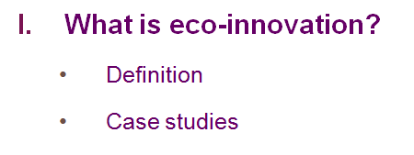

Slide 10
Definition
Eco-innovations are “innovations whose environmental impact on a life cycle basis is lower than those of relevant alternatives”.
Kemp and Oltra (2011: 249). All eco-innovation references are in the paper quoted below.
3 categories of env. impacts:
Pollutions
Exhaustion of nat. resources
Global env. changes
For a literature review on eco-innovations: Cecere, G., N. Corrocher, et al. (2014). Lock-in and path dependence: An evolutionary approach to eco-innovations. Journal of Evolutionary Economics 24(5): 1037-1065.

Slide 11
Commonalities between eco-innovations and standard innovations
Case studies: What do they tell us?
Require similar resources to be developed & adopted (knowledge, capabilities, coordination and attention).
Development intentional/unintentional.
Differences between eco-innovations and standard innovations
Eco-innovations have to meet specific environmental goals.
The development of eco-innovations depends upon the degree of environmental knowledge and sensibility towards environmental issues on producers’ and consumers’ sides.

Slide 12
Why do eco-innovations succeed?
Decision making processes
Ex. biopolymer technology: centralised established decision processes are the main causes of lock-in (Chadha 2011).
Unlocking process: escape routes found by promoting network diversity (firm alliances, R&D consortia, partnerships, standard organisations, ...).
  Firms fostered knowledge diversity: e.g. bootleg research (motivated employees organise part of the innovation process), technology monitoring (encourages to search outside the usual box), involve employees in firms’ road mapping.

Slide 13
The role of stakeholders
Why do eco-innovations succeed?
    By promoting technological niches and diversity:
Ex. volatile organic compounds (paints, glues): end 1990s: supportive legislation helped more environmentally friendly paints to increase their sales significantly after 30 years on the market (Gelderman et al. 2007; Oltra and Saint Jean 2005).
Public S&T programmes supported niche applications: e.g. calculators and space travel helped improve solar cell efficiency => the technological trajectory of solar cells moved on from a technological niche to a market niche (van den Heuvel and van den Bergh 2009).

Slide 14
The role of regulatory changes
Why do eco-innovations succeed?
Legislative and other regulatory pressures are even the main external forces leading to the adoption of eco-innovations (Nameroff et al. 2004).
Regulatory push is often the first opportunity for firms to start along an eco-innovation path by complying with regulatory standards (van den Heuvel and van den Bergh 2009).
E.g. US large revisions of environmental law during the 1980s and 1990s were followed by a rapid growth in green chemistry patenting.
“There is more evidence of regulations stimulating radical innovation than of market-based instruments doing so.” (Kemp and Pontoglio 2011)

Slide 15
The role of lead users
Why do eco-innovations succeed?
Change in consumer preferences can trigger eco-innovative changes. Ex. the trajectory of personal transportation technologies was disrupted by ecological concerns (Windrum et al. 2009) => awareness important.
Ecological concerns triggered the emergence of heterogeneous consumer preferences => development of cleaner product designs within the dominant technological paradigm => greener paradigm.

Slide 16
The role of lead users
Why do eco-innovations succeed?
Early adopters play a crucial role: attribute meaning to the product => drive eco-innovation by contributing to the emergence of a niche market. E.g. Canadian forestry sector (Sharma and Henriques 2005).
Social process by which early adopters influence markets = social feedback loops (Dijk et al. 2011):
Interactive learning between suppliers and users,
Endogenous tastes among consumers,
Social learning (attribution of meaning).

Slide 17
Example of cars (lock-in due to incremental changes)
Why do eco-innovations fail?
Lack of new infrastructure and capital required for more radical technological changes + sunk costs (Costantini and Mazzanti 2012).
=> emergence of 2 main trajectories (Dijk et al. 2011):
  Improvement of vehicles powered by ICE;
  Slow diffusion of electricity-powered vehicles.

Slide 18
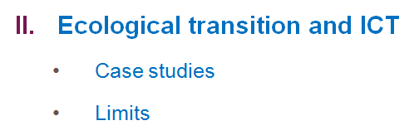

Slide 19
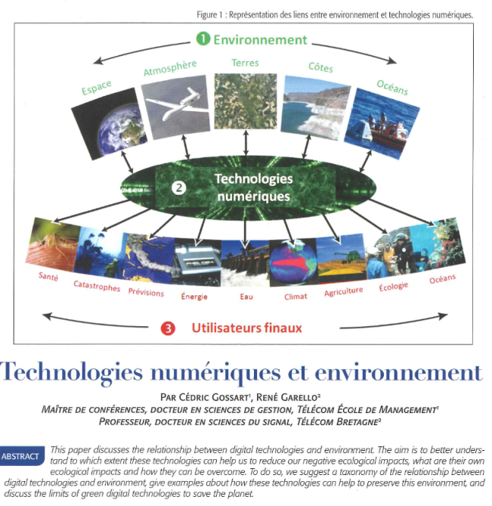

Slide 20
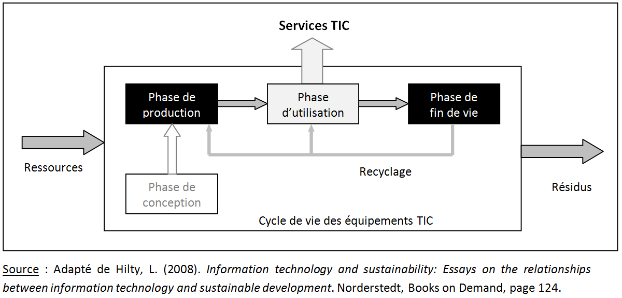
What are the ecological impacts of ICT?
Notes:
These impacts appear at each stage of the lifecycle.

Slide 21
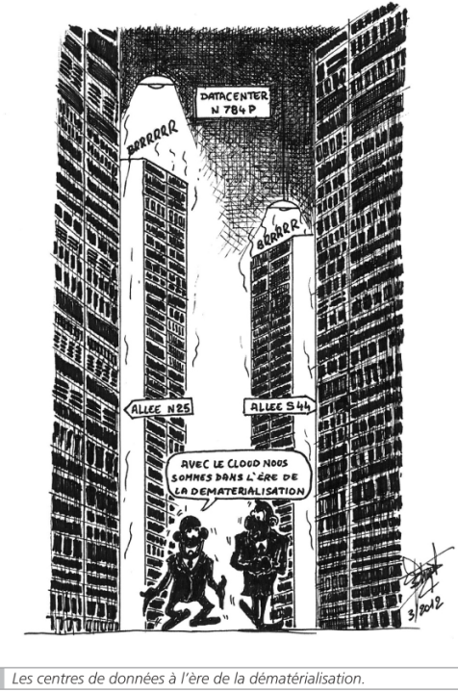

http://telecom-em.eu/content/impacts-ecologiques-des-tic
12/11/2015
Notes:
IT / Information systems equipement waste in space...

Slide 22
Case studies
Ecodesigned ICT:
  Production phase: ecodesign + CSR
  Use phase: responsible consumption
  End-of-life: design for recycling + responsible e-waste management
Use of ICT to reduce ecological impacts in other sectors (IT for green):
  Environmental monitoring
  Awareness raising
  Resource saving

Slide 23
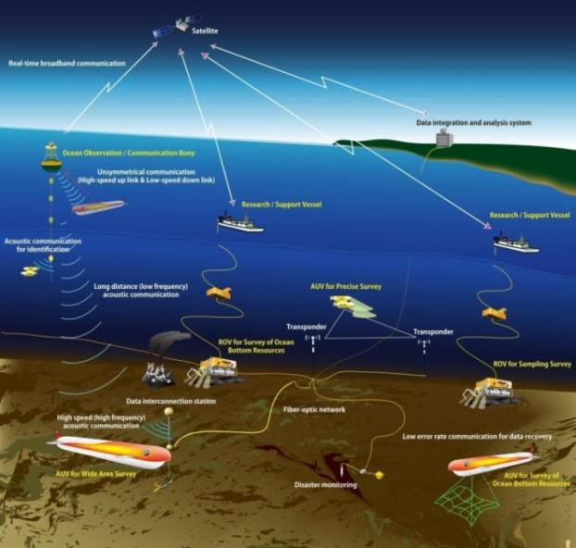
Case n°1:
Environmental monitoring
Sensors & control equipment
Data treatment
Source : Presentation by René Garello.

Slide 24
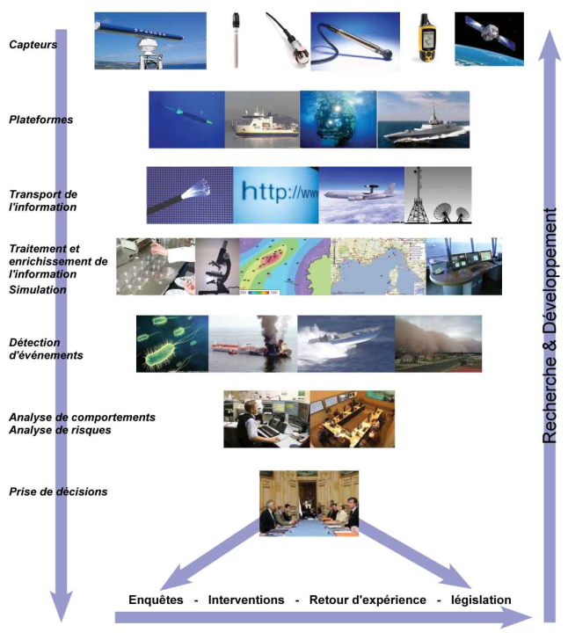
Environmental monitoring
Source : René Garello.

Slide 25
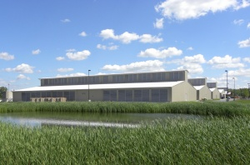
Case n°2: Eco-efficient datacentres
Ex. Yahoo!
PUE = 1,08
40% reduction of energy costs
Cheaper to build
Source : http://www.pcworld.com/article/205728/yahoo_opens_chicken_coop_green_data_center.html.

Slide 26

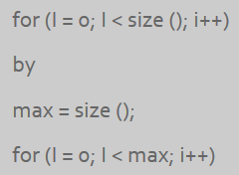
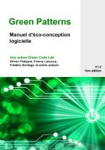
Case n°3: Software ecodesign
Source: http://kaliterre.fr/eng/KaliBlog/Software-Eco-design/Code-Vert-Project-a-complete-Software-Eco-Design-Repository.

Slide 27

Case n°4
Source: http://www.smart2020.org/case-studies/personal-travel-assistant-pta/ .

Slide 28
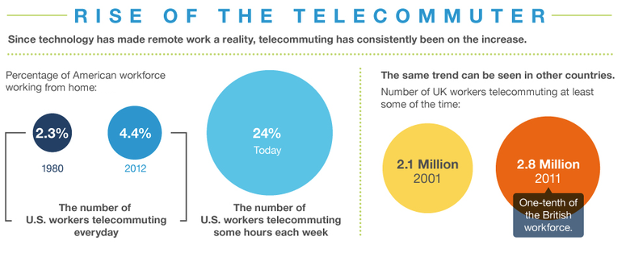
Case n°5: Telecommuting
Source : http://www.zdnet.com/article/death-of-the-office-and-rise-of-the-telecommuter/.

Slide 29


Case n°6: Serious gaming
http://www.fateoftheworld.net/

Slide 30
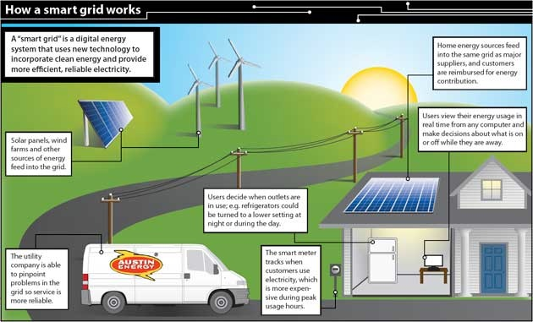
Case n°7: Smart grids

Slide 31
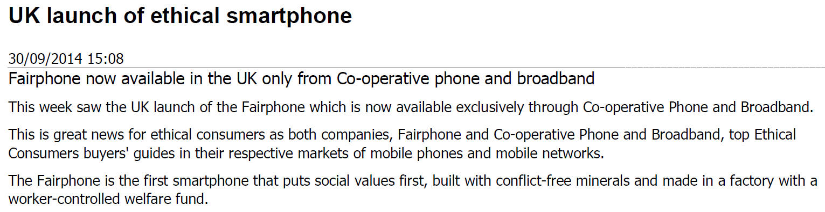
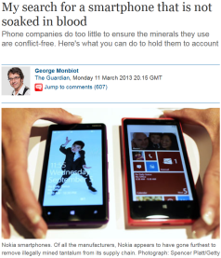
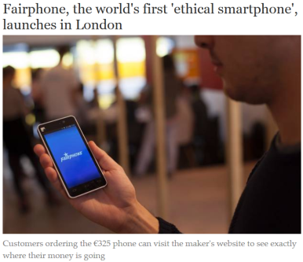
Case n°8: The fair phone
http://www.ethicalconsumer.org/latestnews/entryid/1687/uk-launch-of-ethical-smartphone.aspx
http://www.independent.co.uk/life-style/gadgets-and-tech/fairphone-the-worlds-first-ethical-smartphone-launches-in-london-8829444.html
http://www.theguardian.com/commentisfree/2013/mar/11/search-smartphone-soaked-blood

Slide 32

Limits to eco-innovation:
Rebound effects
For a literature review: Gossart, C. (2015). Rebound Effects and ICT: A Review of the Literature. In ICT Innovations for Sustainability. L.M. Hilty and B. Aebischer, Springer International Publishing, n°310, pp. 435-448.

Slide 33
Examples of direct rebound effects
Limits to eco-innovation
Microprocessors are continuously smaller =>
  Their price drops
  Their demand explodes
  New models offset slower obsolete ones
Server virtualisation =>
  Less hardware required to provide the same service
  Online data storage prices decreases
  Demand for data storage space skyrockets

Slide 34
Examples of indirect rebound effects
Limits to eco-innovation
Telecommuting:
  Saves time but can lead to an increase in gasoline consumption if leads to longer commutes.
Telecommuting: substantial part of transport savings nullified by increased transport for other purposes*:
  E.g. in Denmark: 105 km of weekly commuting were saved … but in the mean time 77 km were driven for private purposes (hence rebound effect of 73%).
* Falch, M.: Environmental Impact of ICT on the Transport Sector. In: Hadjiantonis, A., Stiller, B. (eds.) Telecommunication Economics, vol. 7216. Lecture Notes in Computer Science, pp. 126-137. Springer Berlin Heidelberg, (2012).

Slide 35
Final remarks
Eco-innovation needs social innovations:
Behavioural changes (ecodesign in firms, responsible consumers)
Regulatory pressures
Knowledge diversity
Ecological awareness raising
To avoid rebound effects
Notes:
ecodesign in firms: no more planned obsolescence!

Slide 36
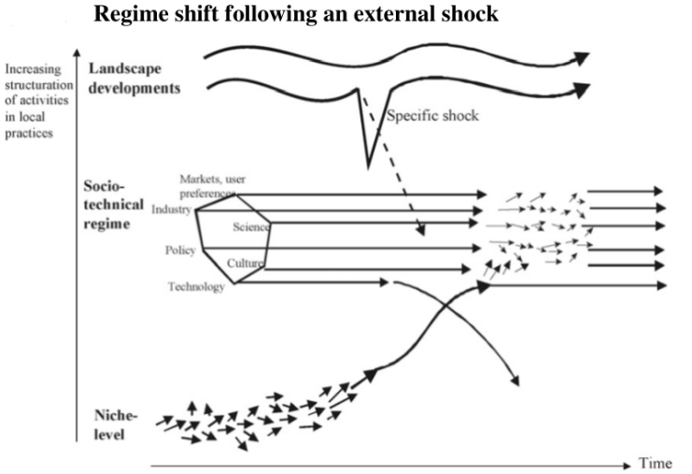
An important limit of management sciences = lack of integrated perspective
Source: Geels and Schot (2007: 410). References available from https://gossart.wp.mines-telecom.fr/files/2014/07/Gossart-paper_STRN.pdf.

Slide 37



Thank you.
http://gossart.wp.mines-telecom.fr
Cedric.Gossart@telecom-em.eu
Co-animator of the interdisciplinary ICT & Environment Research Network of IMT
http://rt08.wp.mines-telecom.fr

