Slide 1
http://terminal.revues.org/

Slide 2
Institut Mines-Télécom
26 engineering & business schools
http://www.mines-telecom.fr/

Slide 3
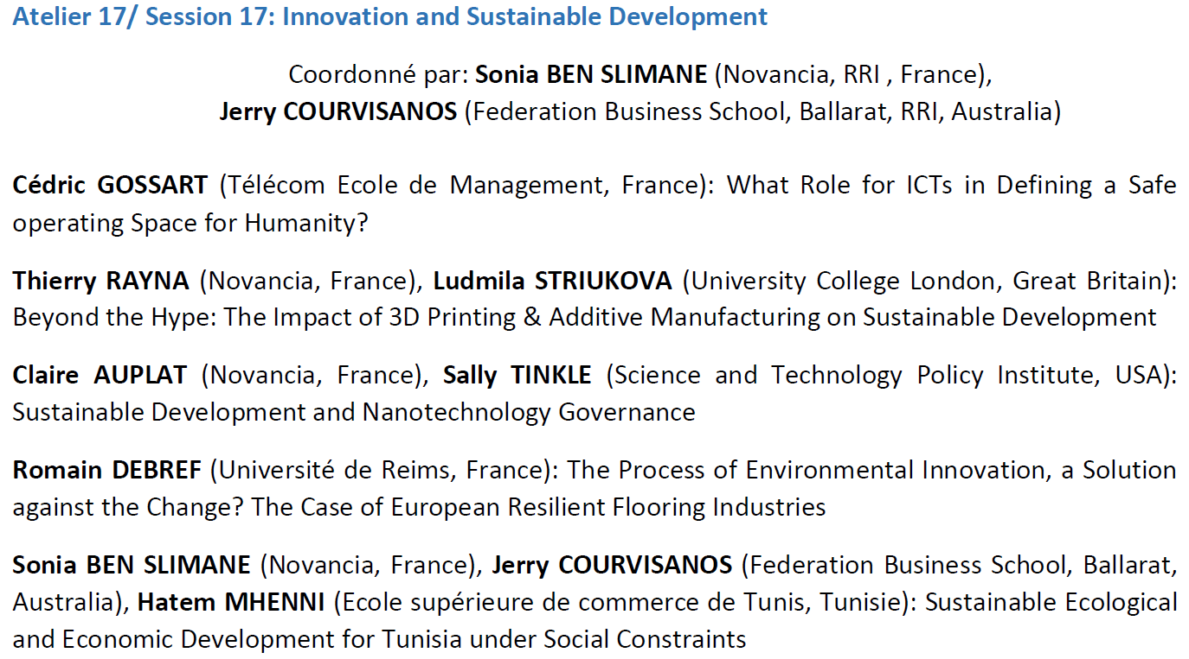

Slide 4
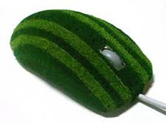
The social aspects of ecological transitions: The case of lighting
Cédric GOSSART
Associate professor in TEM
Forum Innovation, Session 14, 10/06/2016.

Slide 5
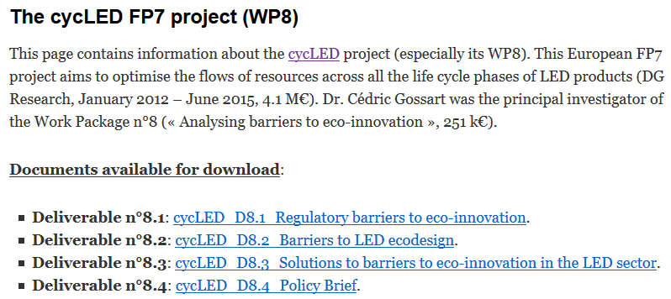
http://www.cyc-led.eu
https://gossart.wp.mines-telecom.fr/cycled/

Slide 6
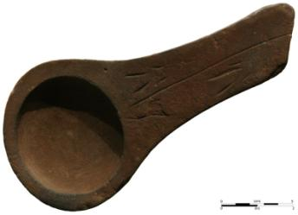
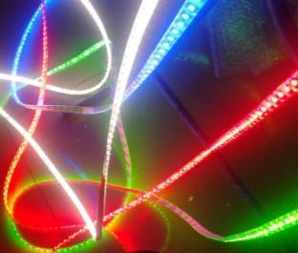
The case of lighting transition
Animal oil lamp, Lascaux, -10000.
https://fr.wikipedia.org/wiki/Lampe_à_huile
LED ribbons
-10,000
2015

Slide 7
Lighting in the world
IEA: the amount of electricity used by lighting sources = 20% global electricity consumption.*
Lighting = greatest share of electricity expenses of many municipalities (=> hydrocarbon energy sources).
Nowadays: switch to LED technologies (reduced ecological impacts).
* Source: Aman, M. M., G. B. Jasmon, et al. (2013). Analysis of the performance of domestic lighting lamps. Energy Policy 52(0), pp. 482-500.

Slide 8
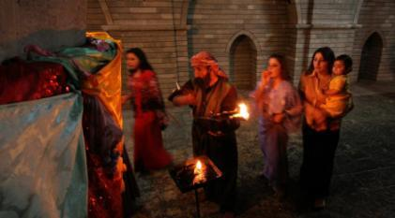
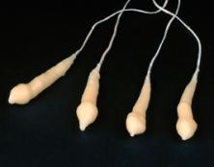
Lighting in a nutshell: Stage 1 (flame-based lighting)
Fuel combustion dominated the long history of lighting:
4,500 years ago: in modern day Iraq oil lamps were used to burn oils made from olives and seeds.
2,000 years ago: the first candles appeared in Rome.
Source: http://www.religion.dk/viden/hvem-er-yazidierne.
Tallow candles (rendered animal fat)
Source: http://www.smith.edu/hsc/museum/ancient_inventions/candles2.html.
Sources: Bowers, B. (1980); Freeberg (2013). References available from https://gossart.wp.mines-telecom.fr/files/2014/07/Gossart-paper_STRN.pdf.

Slide 9
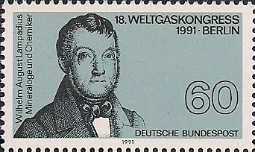
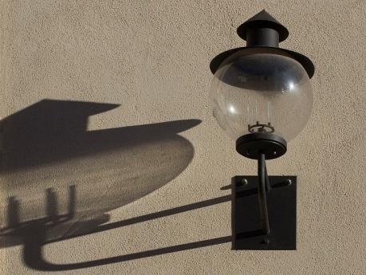
200 years ago: first gasworks established in Freiburg by Wilhelm August Lampadius (German mineralogist).
Lighting in a nutshell: Stage 1 (flame-based lighting)
Source: https://de.wikipedia.org/wiki/Wilhelm_August_Lampadius.

Slide 10
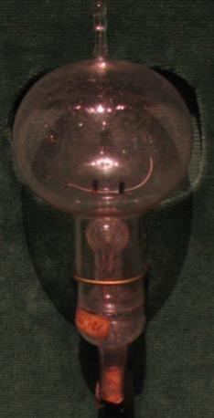
Lighting in a nutshell: Stage 2 (electricity-based lighting)
Edison's original carbon-filament bulb
Early work on incandescent lamps dates from 1840
October 1879: Edison’s ‘filament lamp’
1881: Edison’s company manufactures complete lighting systems (wiring, switches, lamps...)
1962: red light emitting diodes/LED (Holonyak / GE)
1994: blue LED (Nakamura from Nichia)
1997: white LED (Nichia)
Source: https://en.wikipedia.org/wiki/Incandescent_light_bulb.
Sources: Bowers, B. (1980); Freeberg (2013). References available from https://gossart.wp.mines-telecom.fr/files/2014/07/Gossart-paper_STRN.pdf.

Slide 11
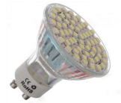
What is the environmental future of lighting?
LED
Highly innovative field (see my paper with Cecere et al., Research Policy, July 2014).
Source: Wissema (1982), quoted in Olleros (1986: 7). References available from https://gossart.wp.mines-telecom.fr/files/2014/07/Gossart-paper_STRN.pdf.

Slide 12
The ecological impacts of the lighting transition
Source: De Almeida, Santos et al. (2014: 32). References available from https://gossart.wp.mines-telecom.fr/files/2014/07/Gossart-paper_STRN.pdf.

Slide 13
The ecological impacts of the lighting transition
Source: http://www.cree.com/News-and-Events/Cree-News/Press-Releases/2014/March/300LPW-LED-barrier, March 2014.

Slide 14
The ecological impacts of the lighting transition
The efficacy of LED is much superior to that of other alternatives
Source: The Climate Group (2012). References available from https://gossart.wp.mines-telecom.fr/files/2014/07/Gossart-paper_STRN.pdf.

Slide 15
The ecological impacts of the lighting transition
Source: Aman et al. (2013). References available from https://gossart.wp.mines-telecom.fr/files/2014/07/Gossart-paper_STRN.pdf.

Slide 16
Current lighting systems: more heat than light!
Source: Holmes (1997: 29). References available from https://gossart.wp.mines-telecom.fr/files/2014/07/Gossart-paper_STRN.pdf.
Notes:
Only 8% of the energy consumed to light roads is actually used to produce downward light.
;-) Phil Mirowsky, More heat than light, 1989, CUP.

Slide 17
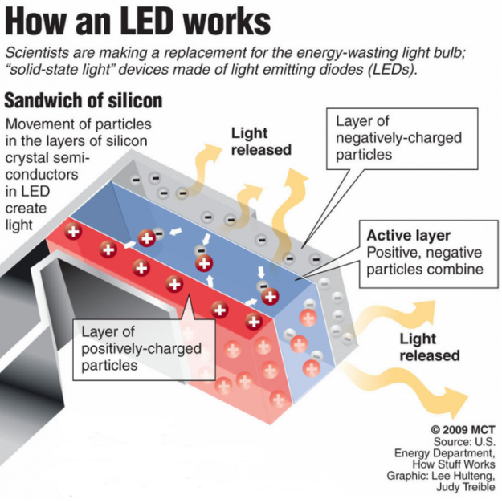
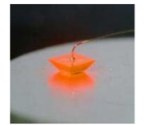
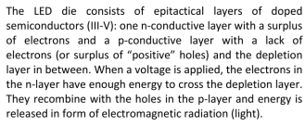
Source: cycLED Deliverable 2.1: Categorization of LED products.

Slide 18
Examples of LED products
Source: cycLED Deliverable 2.1: Categorization of LED products.

Slide 19
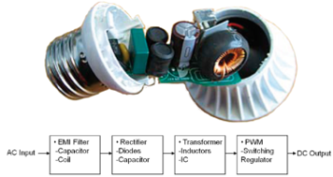
LEDs generate electronic waste
Source: New research shows CFLs and LED light bulbs have higher toxicity and resource depletion than incandescent bulbs. 16/01/2013, http://www.electronicstakeback.com/2013/01/16/new-research-shows-cfls-and-led-lightbulbs-have-higher-toxicity-and-resource-depletion-than-incandescent/.
Original article: http://www.researchgate.net/publication/233913041_Potential_Environmental_Impacts_from_the_Metals_in_Incandescent_Compact_Fluorescent_Lamp_(CFL)_and_Light-Emitting_Diode_(LED)_Bulbs.
Notes:
Only 8% of the energy consumed to light roads is actually used to produce downward light.
;-) Phil Mirowsky, More heat than light, 1989, CUP.

Slide 20
What will drive the ecological transition of lighting?
New practices!
Source: Geels and Schot (2007: 410). References available from https://gossart.wp.mines-telecom.fr/files/2014/07/Gossart-paper_STRN.pdf.

Slide 21
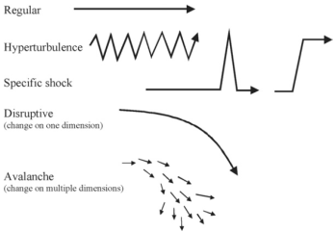
The multilevel perspective (MLP) on ecological transitions
New sociotechnical regime
Source : Geels, F. and J. Schot (2007). "Typology of sociotechnical transition pathways." Research Policy 36(3): 399-417.

Slide 22
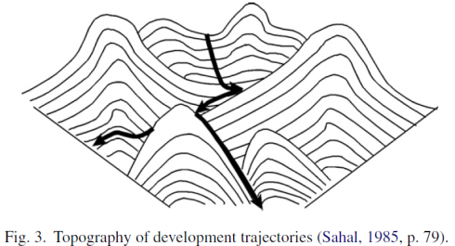
How can we learn more from these aspects?
The social aspects of eco-innovation largely determine the emergence and diffusion of eco-innovations.
We can learn about the social aspects of eco-innovation by studying the role of these social aspects in past technological transitions (including lighting).
Ex. role of social aspects in a transition: government policy (e.g. phasing out of IL bulbs or of CFCs).
Source : Geels, F. and J. Schot (2007). "Typology of sociotechnical transition pathways." Research Policy 36(3): 399-417.

Slide 23
Example n°1: Waste water management in the Netherlands

Slide 24
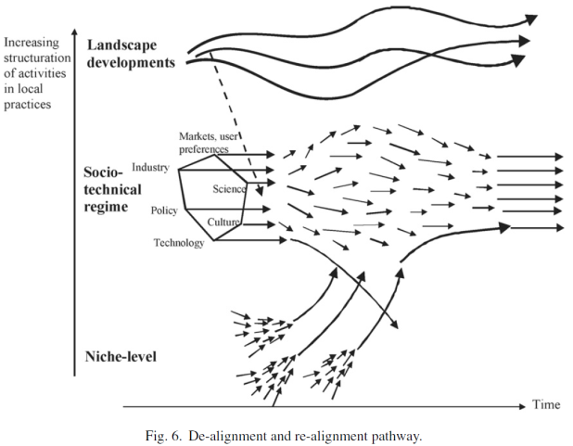
Example n°2: From horse carriages to automobiles.
New sociotechnical regime

Slide 25
Example n°3: From sailing ships to steam-powered boats
1838
social innovation
(public policy)

Slide 26
Example n°3: From sailing ships to steam-powered boats
1838 : social innovation (public policy)

Slide 27
Past lighting transitions
Source: Bowers, B. (1998), Lengthening the day: A History of Lighting Technology, Oxford University Press.

Slide 28
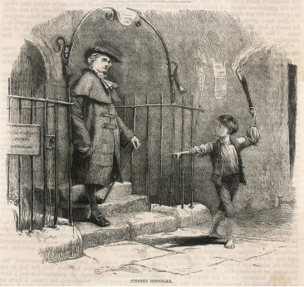
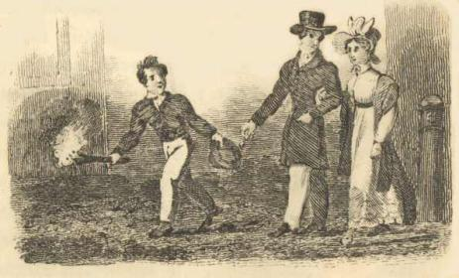
The social aspects of past lighting transitions
“Link boys”
Source: https://janeaustensworld.wordpress.com/2012/04/25/the-difficulties-of-travel-and-transportation-in-early-19th-c-britain/

Slide 29
Lighting and socialising in the 19th c.

Slide 30
Two main categories of lighting
What are the social aspects of their ecological transition?

Slide 31
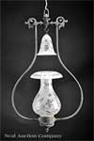
Flame-based light: carbon compounds are heated, become incandescent.
Examples of lighting fuels:
Spermaceti
Stearine
Beeswax
Tallow
Scottish crusie oil lamp
smoke bells for candle holders

Slide 32
Argand lamp (1780)
An eco-innovation?
Improvement in brightness,
More complete combustion of the wick and oil.
Noticeable social aspect: meets a social need for greater efficiency + comfort improvement + saving raw materials.

Slide 33
The consequences of the diffusion of gas light
Fast diffusion of street lighting → electric lighting:
First public street lighting with gas: London 1807
1813: Westminster Bridge lit by gas
1820: 15 towns
1840: 200 towns
1849: 99% towns in Britain
Ecological and social aspects of electric lighting?

Slide 34
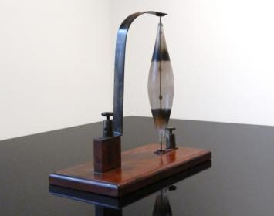
Electricity-based light
Humphrey Davy (1808), demonstrated a large-scale arc: light without combustion.
1848: first public demo of an arc lamp in National Gallery, but batteries very expensive (SA barrier = electricity generation.
But not very convenient for domestic lighting => lighting by incandescence: first demo February 1879 by Joseph Swan.

Slide 35
Electrification (=> IL, CFL, LED, …)
Result from the deployment of public infrastructures
1st power station = water mill in 1881, then steam engines (1882)
Noticeable social aspects of electrical inventions:
Use of the media for public relations: 1881 Paris international electrical exhibition: flattering papers in the press about Edison’s lamps (written by his staff)
Creation of organisations which are the largest firms today
1909: first newspaper campaign for an electrical product (Osram)

Slide 36
Ecological & social issues?
1913: gas in bulb => extension of lifetime + coiled filament
Phoebus cartel : Osram, Philips, General Electric, … (1924 to 1939) to control the manufacture and sale of light bulbs. Firms’ networks inhibit ecological improvements.
1960: halogen lamp → 1990s with tungsten halogen lamps (longevity, brighter, more efficient).
What drives energy savings in lighting nowdays?

Slide 37
Electricity consumption of lighting (USA)
Technological innovation
Source: http://apps1.eere.energy.gov/buildings/publications/pdfs/ssl/2010-lmc-final-jan-2012.pdf

Slide 38
Electricity consumption of lighting (USA)
Technological innovation
Source: http://apps1.eere.energy.gov/buildings/publications/pdfs/ssl/2010-lmc-final-jan-2012.pdf

Slide 39
Evolution of the energy consumed by street lighting in the USA
-2%
-9%
+18%
-23%
Source: http://apps1.eere.energy.gov/buildings/publications/pdfs/ssl/2010-lmc-final-jan-2012.pdf.

Slide 40
Electricity consumption of lighting (EU)
Regulation (phasing out) & standardisation (energy tag)
Source: https://ec.europa.eu/jrc/sites/default/files/energy-efficiency-status-report-2012.pdf

Slide 41
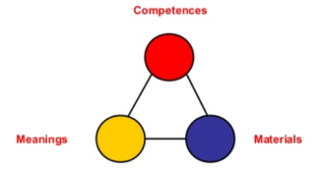
What will drive the ecological transition of lighting?
New practices!
Source: Shove et al. (2012), The Dynamics of Social Practice, Sage.
Behavioural changes (ecodesign in firms, responsible consumers)
Ecological awareness raising
Regulatory pressures
Decentralised infrastructures enabling electricity prosumerism
…
Importance of social practices in transitions.
Notes:
ecodesign in firms: no more planned obsolescence!

Slide 42
Thank you.
http://gossart.wp.mines-telecom.fr
Cedric.Gossart@telecom-em.eu
Co-animator of the interdisciplinary ICT & Environment Research Network of IMT
http://rt08.wp.mines-telecom.fr
10/06/2016
Télécom École de Management

